Slide 1


CE142:OBJECT ORIENTED PROGRAMMING WITH C++
December 2018 – May 2019
UNIT 3
INTRODUCTION TO C++
Devang Patel Institute of Advance Technology and Research

Slide 2


Objectives
Learning the basics of C++ and its applications.
Creating a simple C++ Program.
Unit – 3 : Introduction of C++

Slide 3
Introduction
In this chapter, we will discuss
What is C++?
Simple C++ Program
Applications of C++
Introduction to class, object and creating a simple C++ program
Structure of C++ Program
Unit – 3 : Introduction of C++

Slide 4
C++
C++ Developed in 1979
  Developed by Bjarne Stroustrup
  Developed at Bell Telephone laboratories
  Originally called “C with classes”
  The name C++ is based on C’s increment operator (++)
    Indicating that C++ is an enhanced version of C
Unit– 3 : Introduction of C++

Slide 5
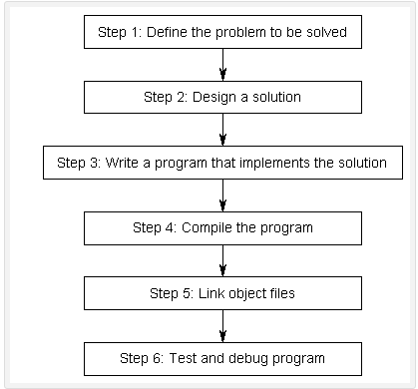
Development of Program
Unit – 3 : Introduction of C++

Slide 6
Compiling
The job of the compiler is:
  To check your program and make sure it follows the rules of the C++ language
    If it does not, the compiler will give you an error to help pinpoint what needs fixing
  To convert each file of source code into a machine language file called an object file
Unit – 3 : Introduction of C++

Slide 7
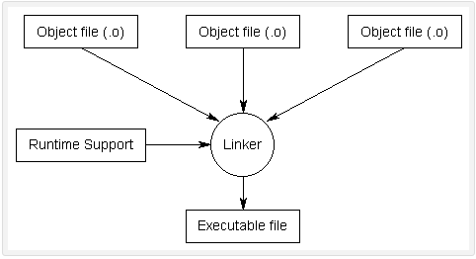
Linking
Process of taking all the object files generated by the compiler and combining them into a single executable program that you can run
This is done by a program called the linker
Unit – 3 : Introduction of C++

Slide 8
A Simple C++ program
The iostream file
#include <iostream> // include header file
using namespace std;
int main()
{
cout<<"C++ is better than C. \n";
return 0;
}
Comments
Namespace (std where standard class libraries defined)
Output Operator
Unit – 3 : Introduction of C++

Slide 9
A C++ program
/* include headers; these are modules that include functions that you may use in your program; we will almost always need to include the header that defines cin and cout; the header is called iostream.h */
#include <iostream.h>
int main() {
//variable declaration
//read values input from user
//computation and print output to user
return 0;
}
After you write a C++ program you compile it; that is, you run a program called compiler that checks whether the program follows the C++ syntax
  if it finds errors, it lists them
  If there are no errors, it translates the C++ program into a program in machine language which you can execute
Unit – 3 : Introduction of C++

Slide 10
Contd..
what follows after // on the same line is considered comment
indentation is for the convenience of the reader; compiler ignores all spaces and new line ; the delimiter for the compiler is the semicolon
all statements ended by semicolon
Lower vs. upper case matters!!
  Void is different than void
  Main is different that main
Unit – 3 : Introduction of C++

Slide 11
Hello world program
Here is the Hello world program in C++.
#include <iostream.h>
int main()
{
cout << “Hello world!”;
return 0;
}
Unit – 3 : Introduction of C++

Slide 12
Contd..
// my first program in C++
#include <iostream>
int main()
{
std::cout << "Hello World!";
}
Unit – 3 : Introduction of C++

Slide 13
Contd..
#include <iostream>
Lines beginning with a hash sign (#) are directives read and interpreted by what is known as the preprocessor. They are special lines interpreted before the compilation of the program itself begins.
In this case, the directive #include <iostream>, instructs the preprocessor to include a section of standard C++ code, known as header iostream, that allows to perform standard input and output operations, such as writing the output of this program (Hello World) to the screen.
Unit – 3 : Introduction of C++

Slide 14
Contd..
std::cout << "Hello World!";
This line is a C++ statement.
A statement is an expression that can actually produce some effect.
Statements are executed in the same order that they appear within a function's body.
Unit – 3 : Introduction of C++

Slide 15
Using namespace std
If you have seen C++ code before, you may have seen cout being used instead of std::cout.
Both name the same object: the first one uses its unqualified name (cout), while the second qualifies it directly within the namespace std (as std::cout).
cout is part of the standard library, and all the elements in the standard C++ library are declared within what is called a namespace: the namespace std.
Unit – 3 : Introduction of C++

Slide 16
Contd..
In order to refer to the elements in the std namespace a program shall either qualify each and every use of elements of the library (as we have done by prefixing cout with std::), or introduce visibility of its components. The most typical way to introduce visibility of these components is by means of using declarations:
    using namespace std;
Unit – 3 : Introduction of C++

Slide 17
Example
// my second program in C++
#include <iostream>
using namespace std;
int main ()
{
cout << "Hello World! ";
cout << "I'm a C++ program";
}
Unit – 3 : Introduction of C++

Slide 18
more C++ statements
#include <iostream>
using namespace std;
int main()
{
float number1, number2, sum, average;
cout << "enter two numbers: ";
cin >> number1;
cin >> number2;
sum = number1 + number2;
average = sum/2;
cout << "sum =" << sum << "\n";
cout << "Average =" << average << "\n";
return 0;
}
Variable
Input Operator
Cascading of I/O Operators
Unit – 3 : Introduction of C++

Slide 19

Comments
// This is a C++ program. It prints the sentence:
// Welcome to C++ Programming.
Or
/*
You can include comments that can
occupy several lines.
*/
Unit – 3 : Introduction of C++

Slide 20
Variable declaration
type variable-name;
Meaning: variable <variable-name> will be a variable of type <type>
Where type can be:
  int //integer
  double //real number
  char //character
Example:
int a, b, c;
double x;
int sum;
char my-character;
Unit – 3 : Introduction of C++

Slide 21
Input statements
cin >> variable-name;
Meaning: read the value of the variable called <variable-name> from the user
The operator >> is known as the extraction or get from operator.
It extracts the value from the keyboard and assigns it to the variable on the right.
Example:
cin >> a;
cin >> b >> c;
cin >> x;
cin >> my-character;
Unit – 3 : Introduction of C++

Slide 22
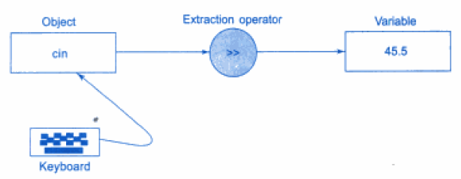
Input Operator
Unit – 3 : Introduction of C++

Slide 23
Output statements
cout << variable-name;
Meaning: print the value of variable <variable-name> to the user
cout << “any message”;
Meaning: print the message within quotes to the user
cout << endl;
Meaning: print a new line
The operator << is known as the insertion operator.
Multiple use of << in one statement is known as cascading.
Example:
cout << a;
cout << b << c;
cout << “This is my character: “ << my-character << “ he he he”
<< endl;
Unit- 3 : Introduction of C++

Slide 24
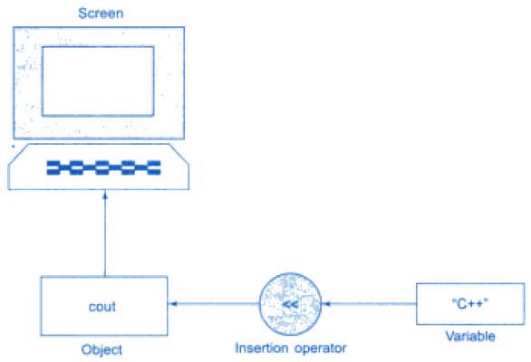

Output Operator
cout<< “c++ is better than c”;
cout<<name;
The operator << is called as insertion or put to operator
Unit – 3 : Introduction of C++

Slide 25
Cascading I/O Operators
The multiple use of << or >> in one statement is called cascading.
Example:-
cout<< “ sum”<< sum << “\n”
First sends the string “sum=“ to cout and then sends the value of sum.
Finally, it sends the newline character so that the next output will be in the new line.
Example:-
cin>>number1>>number2;
Unit – 3 : Introduction of C++

Slide 26
Access Modifiers
Accessing a data member depends solely on the access control of that data member.
This access control is given by Access modifiers in C++.
There are three access modifiers :
  public
  private
  protected
Unit – 3 : Introduction of C++

Slide 27
Contd..
Public: A public member is accessible from anywhere outside the class but within a program.
Private: A private member variable or function cannot be accessed, or even viewed from outside the class. Private members can only be accessed by member functions of the same class or friends. This means derived classes can not access private members of the base class directly!
Protected: A protected member variable or function is very similar to a private member but it provided one additional benefit that they can be accessed in child classes which are called derived classes.
Unit – 3 : Introduction of C++

Slide 28
Creating Simple program using class
#include<iostream>
using namespace std;
void show();
class Test
{
public:
void show()
{
cout << "I am a member function of class"<<"\n";
}
};
int main()
{
Test t;
t.show();
show();
}
void show()
{ cout << "I am a function defined outside the class"<<"\n";}
Unit – 3 : Introduction of C++

Slide 29
Common escape sequences
Escape Sequences | Character
\a | Bell (beep)
\b | Backspace
\f | Formfeed
\n | Newline
\r | Return
\t | Tab
\\ | Backslash
\’ | Single quotation mark
\’’ | Double quotation marks
\xadd | Hexadecimal representation
Unit – 3 : Introduction of C++

Slide 30
Structure of C++ program
Include files
Class declarations
Member functions definitions
Main function program
Unit – 3 : Introduction of C++

Slide 31
The client-server model
Member function
Server
Class definition
Main function program
Client
Unit – 3 : Introduction of C++

Slide 32
Real World Applications of C++
Games
Graphic User Interface (GUI) based applications
Web Browsers
Advance Computations and Graphics
Database Software
Operating Systems
Enterprise Software
Medical and Engineering Applications
Compilers
Unit – 3 : Introduction of C++

Slide 33
Versions of C++
Apple C++
Borland C++
GNU C++ for Linux
IBM C++ for IBM power, System Z
SGI C++
Sun C++
Microsoft Visual C++ under .Net
Turbo C++
Unit – 3 : Introduction of C++

Slide 34
C++ versus C
The following features of C++ language or library is not supported in C:
Classes
Constructors and destructors
Exceptions and try/catch block
Function overloading
Member functions
Namespaces
New and delete operators
Operator overloading
Standard template library (STL) [cmath, iostream, cstdlib, cstring and many more]
Unit – 3 : Introduction of C++

Slide 35
Possible Future Additions to C++
It is speculated that the following new features will be added to C++ in future:
Automatic garbage collection
Object persistence
Support for concurrency and multithreading
Extensible member functions
Dynamically linked libraries
Rule based programming
Unit – 3 : Introduction of C++

Slide 36
Summary
C++ supports interactive input and output features.
A typical C++ program would contain 4 basic sections namely file section, class declaration section, member function section and main function section.
Unit – 3 : Introduction of C++

Slide 37
Exercise
WAP to display the following output using a single cout statement.
  Maths=90
  Physics=77
WAP that inputs a character from the keyboard and displays its corresponding ASCII value on the screen
WAP to read two numbers from the keyboard and display the larger value on the screen
WAP in C++ to print the sum of two numbers.
WAP in C++ to calculate the volume of a sphere.
Unit – 3 : Introduction of C++

Slide 38
Find errors, if any, in the following C++ statements
cout<<“x=“”x;
m=5;//n=10;//s=m+n;
cin>>x;>>y;
cout<<\n “Name:”<<name;
cout<<“Enter value:”; cin>>x;
/*Addition*/ z=x+y;
Unit – 3 : Introduction of C++

Slide 39
Fill in the blanks
The default access specifier for the class members is_______.
‘cin’ is an __________.
Runtime polymorphism is done using___________.
Which feature of the OOPS gives the concept of reusability?
Mention the real time applications of C++.
Unit – 3 : Introduction of C++

Slide 40
Review questions
How does a main() function in C++ differ from main() in C?
Describe the major parts of a C++ program.
Why do we need the preprocessor directive #include <iostream>?
List commonly used old-style header files along with the contents and purpose and new version of the same.
List new header files included in ANSI C++
Applications of C++
Unit – 3 : Introduction of C++

Slide 41
Multiple Choice Questions
An expression A.B in C++ means ____
a. A is member of object B b. B is member of object A
c. Product of A and B d.None of these
A C++ code line ends with ___
a. A Comma (,) b. A Fullstop(.)
c. A Semicolon (;) d. A Slash (/)
Identify the C++ compiler of Linux
a.cpp b.g++
c.Borland d.vc++
The default access specifier for the class members is
a.Public b.Private
c.Protected d.None of these
Unit – 3 : Introduction of C++

Slide 42
MCQ Answer
B
C
B
B
Unit – 3 : Introduction of C++

Slide 43







Presentation Prepared By:
  Contact us:
  dweepnagarg.ce@charusat.ac.in
  parthgoel.ce@charusat.ac.in
  hardikjayswal.it@charusat.ac.in
  krishnapatel.ce@charusat.ac.in
  khushipatel.ce@charusat.ac.in
  michelemistry.ce@charusat.ac.in
  Ms. Michele Mistry
  Ms. Krishna Patel
  Ms. Dweepna Garg
  Subject Coordinator
Subject Teachers:
  Mr. Parth Goel
  https://parthgoelblog.wordpress.com
Mr. Hardik Jayswal
Ms. Khushi Patel
Devang Patel Institute of Advance Technology and Research

Slide 44
Thank You
Unit – 3 : Introduction of C++

